Slide 1
AI in Education:
Forecasting with Neural Networks
Tomislav Medić, mag.oec.
Department of Informatics
Faculty of Economics & Business - Zagreb

Slide 2
Content
1. A little bit about AI
4. Forecasting
What exactly is AI?
How does it work?
How can AI look into the future?
How can we use it?
2. What are Neural Networks
5. The Future
Why Neural Networks?
Where do they fit in?
What can we expect in the future?
Q&A
Debate
3. Data
Why is data important for AI?
How do we collect data?
How do we use data?

Slide 3
INTRO
Artificial Intelligence
Neural Networks
How?
Artificial intelligence Artificial Intelligence – AI is a technology that allows computers to learn from experience, adapt to different tasks and perform tasks currently performed by humans
Most successful AI projects today rely heavily on Deep learning and Natural language processing
With this technology, computers can be trained to perform specific tasks by processing large amounts of data and recognizing patterns in data.

Slide 4
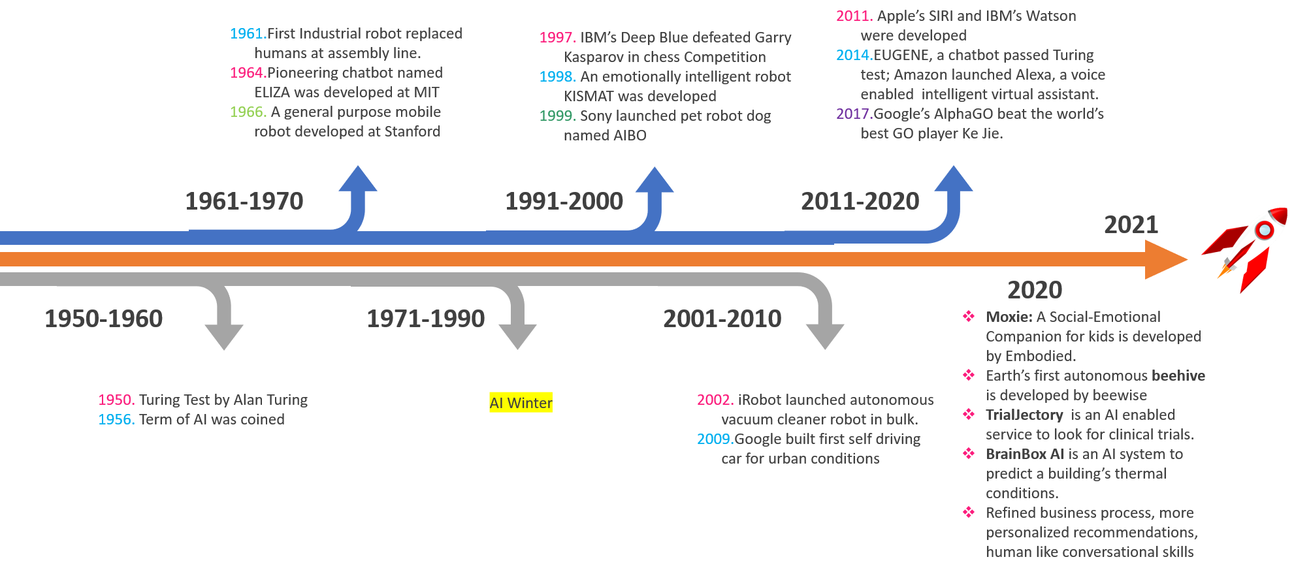

Slide 5
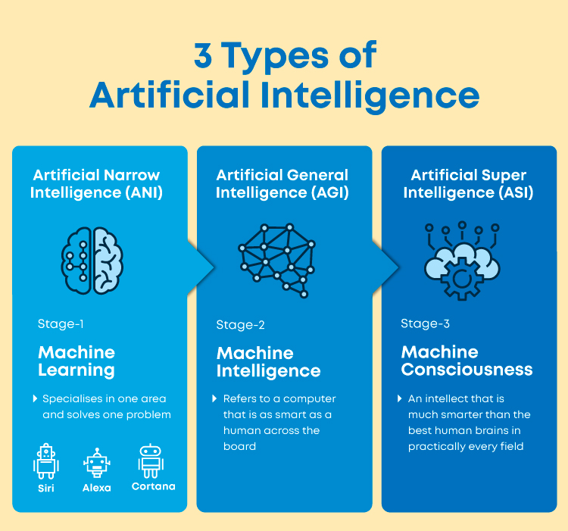

Slide 6
Deep learning
Deep learning is a specific area of machine learning: a new approach to learning from data that focuses on learning from successive layers of increasingly significant representations (Chollet, 2018).
Modern deep learning often involves dozens, hundreds or more of successive layers of representation, all of which are taught automatically when exposed to test data.
Or simply, deep learning is a mathematical framework for learning representations from data

Slide 7
NEURAL NETWORKS

Slide 8
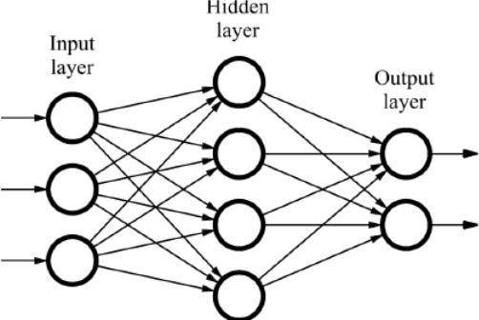
Neural Networks
Neural networks consist of an input layer, 1 or more hidden layers and an output layer
Each layer in the network receives data and gives a result, and between the neurons of each layer there are weights, with which the results are corrected (training the network)

Slide 9
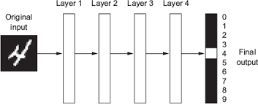
How does it work – „Hello world”
One of the most famous examples is the use of a neural network to identify handwritten digits.
Neural network transforms the image of a digit into representations that are gradually different from the initial, but increasingly informative about the result, that is, the output

Slide 10
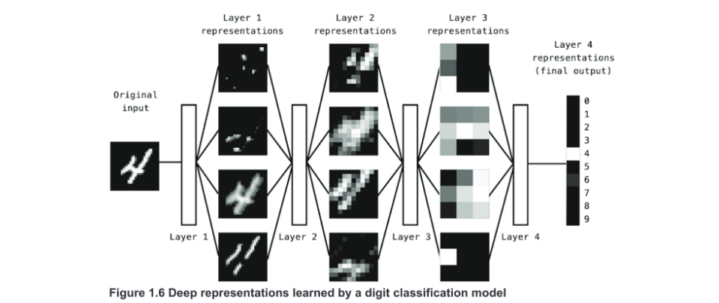
Each layer learns a different representation of the digit, one layer can learn shapes and curves and the other can learn even more abstract representations which might not make much sense to humans, but it helps the algorithm classify digits better.

Slide 11
Types of neural networks
There are a large number of different neural networks, and only some of them are:
Multilayer Perceptron (MLP)
Recurrent Neural Network (RNN)
Long-Short Term Memory (LSTM)
Convolutional Neural Network (CNN)
Spiking Neural Networks (SNN)
…
https://www.youtube.com/watch?v=3JQ3hYko51Y

Slide 12
“These are simple mechanisms that, once scaled, end up looking like magic.”
François Chollet

Slide 13
Where does Deep learning fit in?
With this technology, computers can be trained to perform specific tasks by processing large amounts of data and recognizing patterns in data.
There is a long history of the development of artificial intelligence, however, for the first time in history the processing power and the amount of data available allow effective application of this technology to almost all areas

Slide 14
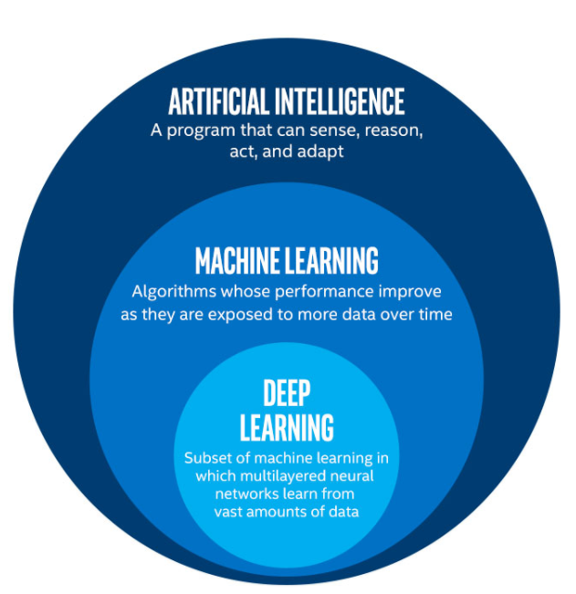

Slide 15
Some examples (1/2)
Computer vision
Real-time computer vision and operations (self-driving cars - autopilot, drones)
Forecasting
Ability to analyze huge amounts of data (Netflix, weather forecasts, traffic forecasts, stock prices, etc.)
Analysis
Modeling and analysis - self-organizing maps, clustering, classification

Slide 16
Some examples (2/2)
Natural language processing
Voice-to-text, smart assistants (Siri, Alexa)
Data mining, text mining
Google, Facebook, Microsoft etc.
Online shopping
Tracking consumer habits, recommendations, web search, etc.

Slide 17
DATA

Slide 18
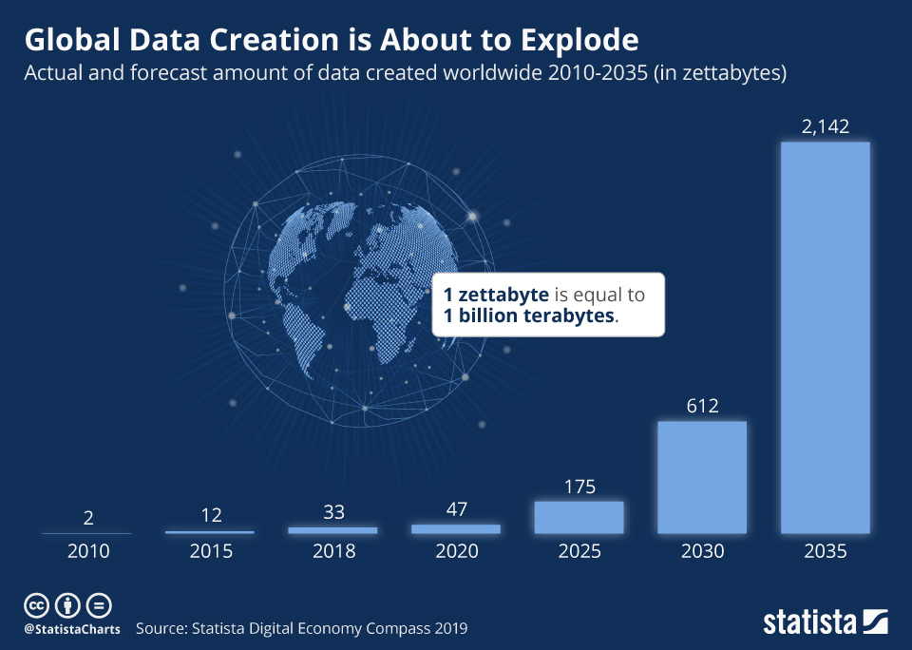

Slide 19
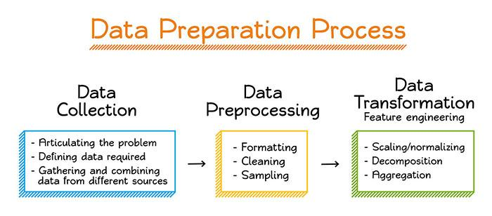
Collecting and preparing the data

Slide 20
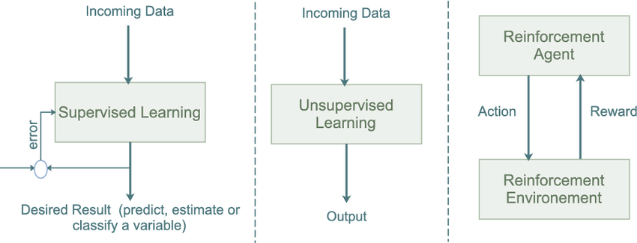
Supervised vs. unsupervised vs. reinforcement learning
https://www.youtube.com/watch?v=Lu56xVlZ40M&t=107s&ab_channel=TwoMinutePapers

Slide 21
Traning the model
(Supervised learning)

Slide 22
FORECASTING
FORECASTING

Slide 23
Can AI look into the future?
Sort of
Few examples
The forecasting of financial data series has been effectively accomplished using neural networks. The linear relationship between inputs and outputs is assumed by the traditional time series prediction techniques like Box-Jenkins and ARIMA. Neural Networks have the advantage that can approximate nonlinear functions.
Banking (churn)
Finances (fraud detection, stock prices)
Weather forecasts
Sales forecasting
Consumer behaviour/preferences

Slide 24
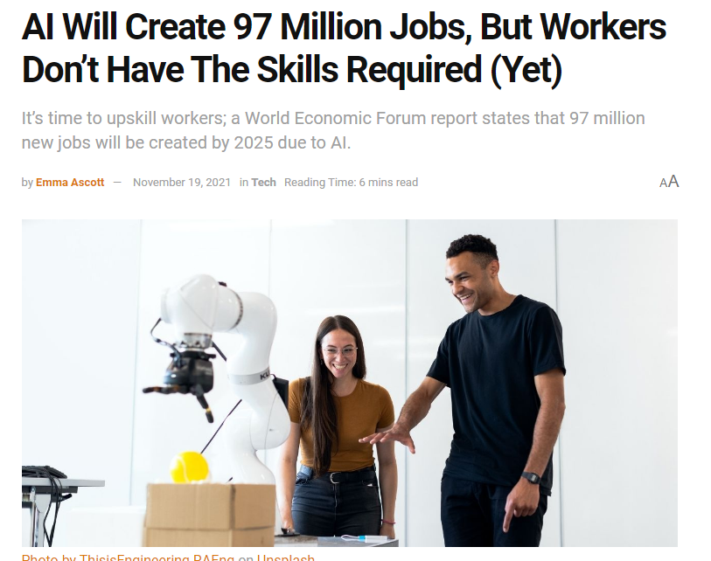
AI in Education (1/2)
By 2025, 85 million jobs, according to the World Economic Forum, will be eliminated by AI.
Contrary to popular belief, automation and AI may potentially result in a substantial increase in the number of new jobs.
The question of how businesses can successfully employ AI in ways that allow - not replace - the human workforce has replaced the earlier one of whether AI would transform the workplace.

Slide 25
AI in Education (2/2)
Job vacancy
Over six million jobs are available across the EU as more than 3% of all open positions are unfilled, a record high since statistical records of this data began in 2006.
In line with this, the EU's jobless rate dropped to 6.0% in July, marking another record low since at least 2001, when Eurostat started gathering statistics for this analysis.

Slide 26
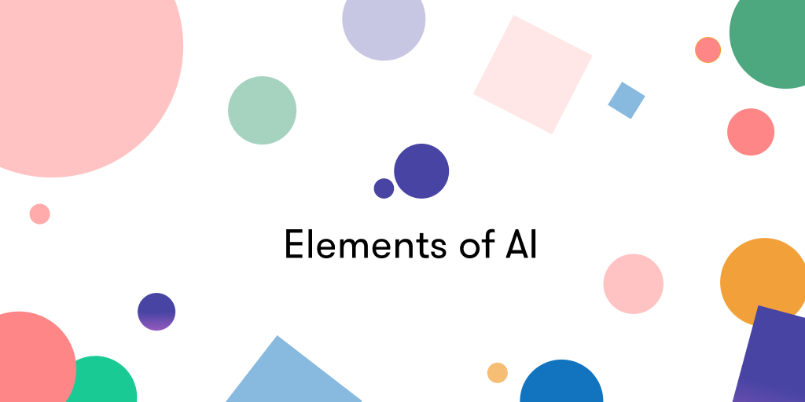
How to do it? – Step 1
https://www.elementsofai.com/

Slide 27
How to do it? – Step 2
Python
R
Third party software
SPSS, Weka, TensorFlow, IBM Watson, OpenNN, Torch.

Slide 28
Thank you for your attention!

