Slide 2
AGENDA
Education challenges
GamificationVS Learning Games
The pedagogical role of game elements
Gamification & Blockchain for Education
It’s time to play!
Let’s practice with Articulate
Digital learning tools

Slide 3
Education challeges
The school, in spite of hardships and difficulties, is increasingly characterized as one of the most important educational and social planning services. It is the bridge between the cultural heritage and the construction of the future.
Two fundamental factors have brought about radical transformations in society:
GLOBALIZATION
NEW INFORMATION TECHNOLOGIES

Slide 4
Education challeges
In a few decades, their developments and their multiple interconnections have not only changed political, social, economic, cultural and environmental problems and perspectives, but have also transformed the very forms of everyday life and interpersonal relations.
Above all, they have radically transformed the ways in which knowledge is
Produced
Stored
Interpreted
Transmitted
Processed

Slide 5
Education challeges
The covid-19 pandemic that has hit the world has highlighted the importance of distance learning tools in overcoming the problem of not being able to meet face-to-face.
After an initial settling-in phase, schools and universities have adapted to the difficult situation and benefit from new learning technologies.

Slide 6
Gamification VS Learning Games
How are they different?
https://youtu.be/Uj_8C2L9bXI

Slide 7
Gamification VS Game-based learning
GAMIFICATION is applying game mechanics to a learning environment to promote desired behavior and to drive learning outcomes.
Gamification applies existing training content and foresees the integration of game elements like point systems, leaderboards, badges, etc. in order to increase engagement and motivation
GAME-BASED LEARNING (GBL) means designing and incorporating training content into games to reach desired learning outcomes.
In a GBL program users learn by playing. Their progress in the game is directly correlated to their knowledge and understanding of the training subject matter.
GAMIFICATION APPLIES GAME ELEMENTS OR A GAME FRAMEWORK TO EXISTING LEARNING ACTIVITIES
GAME-BASED LEARNING DESIGNS LEARNING ACTIVITIES THAT ARE INTRINSICALLY GAME-LIKE

Slide 8
Gamification VS Game-based learning
GAMIFICATION
May just be a collection of tasks with points AND/OR some form of reward.
GAME-BASED LEARNING (GBL)
Games have defined rules & objectives.
Losing may or may not be possible because the point is to motivate people to take some action and do something.
There is a possibility of losing.
Sometimes just playing the game is intrinsically rewarding.
Being intrinsically rewarding is optional.
Gamification is usually easier and cheaper.
Games can be hard and expensive to build.
Usually game like features are added without making too many changes to your content.
Content is usually morphed to fit the story and scenes of the game.

Slide 9
Gamification VS Game-based learning
Both aim to achieve the same goal: to engage and motivate learners. However...
GAMIFICATION
Turns the entire learning process
into a game
GAMES-BASED LEARNING
Use games as part of the learning Process.

Slide 10
Gamification VS Game-based learning
GAMIFICATION
GAME COMPONENTS added to the course
GAME MECHANISM introduced in a non-game setting to encourage engagement
EXTRINSIC REWARDS like badges, awards and achievements are included
EXPERIENCE POINTS may be utilized instead of traditional grades
FLEXIBLE to user requirements in terms of choice of time, environment and pace
CHOICES are allowed as it is not always a linear learning path
GAME-BASED LEARNING
It meets learning OBJECTIVES
LEARNING is the result of playing the game
It can be achieved using customized or off-the-shelf GAMES
PROBLEM SOLVING and critical thinking oriented
It can be accomplished with TACTILE OR DIGITAL GAMES
It could include SIMULATIONS to allow learners to experience the learning

Slide 11
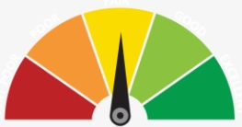
The Pedagogical Role of Game Elements
Points / rewards or experience systems: similar to conventional grading schemes, game points or experience (XP) systems reward students for completing various tasks, assignments, or assessments.
Badges: digital way to award significant achievements. Badges may be displayed to encourage competition.
Leaderboards: competition can motivate students and can be leveraged by analytics elements that give learners a clear view of their progress as well as how they are performing against others
Scores: these help learners get a feeling of achievement and as they view other’s scores, it brings in healthy competition

Slide 12
The Pedagogical Role of Game Elements
A master story: this maps to the objective of the learning journey, and the narrative makes it real and relatable to the learners
Levels: these form the learning path and map to various proficiency levels
Collaboration tasks: these elements can be used when you have team-based approach in Gamification to facilitate collaboration within a team
Challenges: these map to the learning goals
Instant feedback: this aids the learners’ progress and provides them with a clear view on where they stand

Slide 13
Gamification & Blockchain 4 Education
Why Gamification is important to Blockchain?
Increase attractiveness and participation
"Distributed ledger technology is not the most user friendly or easy to grasp. Blockchain gamification is one way to bridge this user gap."
Marketing departments are now using gamification in their marketing activities to reduce customer churn.
Starbucks, for instance, has introduced a loyalty program that enables customers to receive better rewards the more they spend.

Slide 14
Gamification & Blockchain 4 Education
Why Blockchain is important to Education?
Create a security layer for:
Consistency of information stored on the platform
Protect private information during online cooperation
Notes:
A mirror question is: Why Blockchain is important to Education?
We can think about a e-learning platform, in which users insert personal data and make tasks and assignments individually or in groups. With a blockchain approach we can create a security layer for ensure the consistency of information stored on the platform, and protect private information during online cooperation.

Slide 15
Gamification & Blockchain 4 Education
What can Blockchain do for Education?
Create a standard for give user credits, certificates, profiling
Ensure the validity of transaction during learning process
Notes:
In particular, in the education field, blockchain could create a standard for give user credits, certificates and create digital profiling, and ensure the validity of transaction during all phases of the learning process. In this way students could take their digital box with all information and use it in other entities, for example other universities or to certify their competences at work.

Slide 16
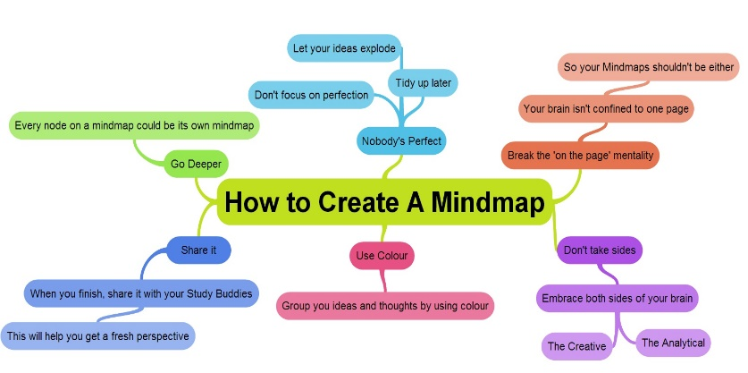
Digital learning tools
Online Mind Maps: an easy way to brainstorm thoughts organically without worrying about order and structure. It allows you to visually structure your ideas to help with analysis and recall.
MIND MUP
https://www.mindmup.com
MIND MEISTER
https://www.mindmeister.com

Slide 17
Digital learning tools
E-Learning Platforms: an integrated set of interactive online services that provide trainers, learners, and others involved in education with information, tools and resources to support and enhance education delivery and management.
Webinars: an online meeting or presentation held via the Internet in real-time.
COURSERA
https://www.coursera.org/
UDEMY
https://www.udemy.com/

Slide 18
Digital learning tools
Educational games: games explicitly designed with educational purposes, or which have incidental or secondary educational value.
European job market:
https://vitecoelearning.eu/missioneurope-game/european-job-market/
Building a city:
https://vitecoelearning.eu/ImmiMATH/Building a city/EN/

Slide 19
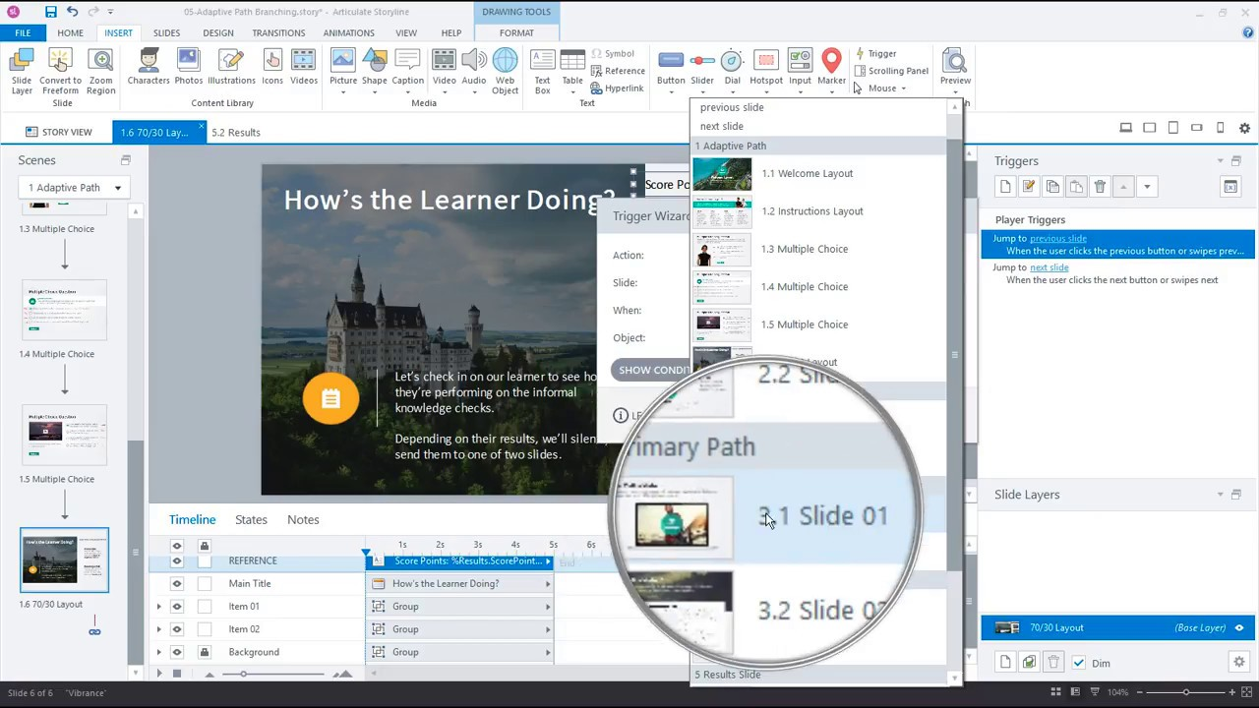
Let’s practice together with ARTICULATE
What is Articulate and how does it work?
Articulate 360 is an authoring tool that allows users to create personalized interactive activities with a responsive design, which means that they are adaptable to any electronic device (smartphone, computer, tablet, etc.).
Lessons can be text or presentation-based and allow users to integrate many different types of content.

Slide 20
Let’s practice together with ARTICULATE
How to create a simple e-learning game in 9 steps:
Step 1: Choose the Gamified Theme
Step 2: Identify the Game Design Elements
Step 3: Set Up the Storyline Project
Step 4: Build the Game Elements
Step 5: Build the First Quiz Question
Step 6: Build the Feedback Slides for the First Quiz Question
Step 7: Adjust the Visual Feedback for the Game Button
Step 8: Create the Remaining Questions and Feedback Slides
Step 9: Create the Introduction and Results Slides

Slide 21
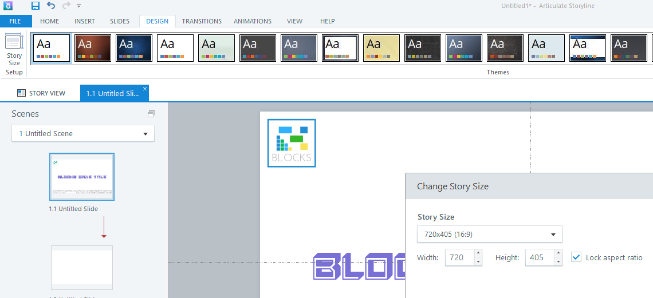
Let’s practice together with ARTICULATE
1: Choose the Gamified Theme
Choose Slide SIZE
Select THEME
Or
Create one
Select FONT
and COLOUR for contents

Slide 22
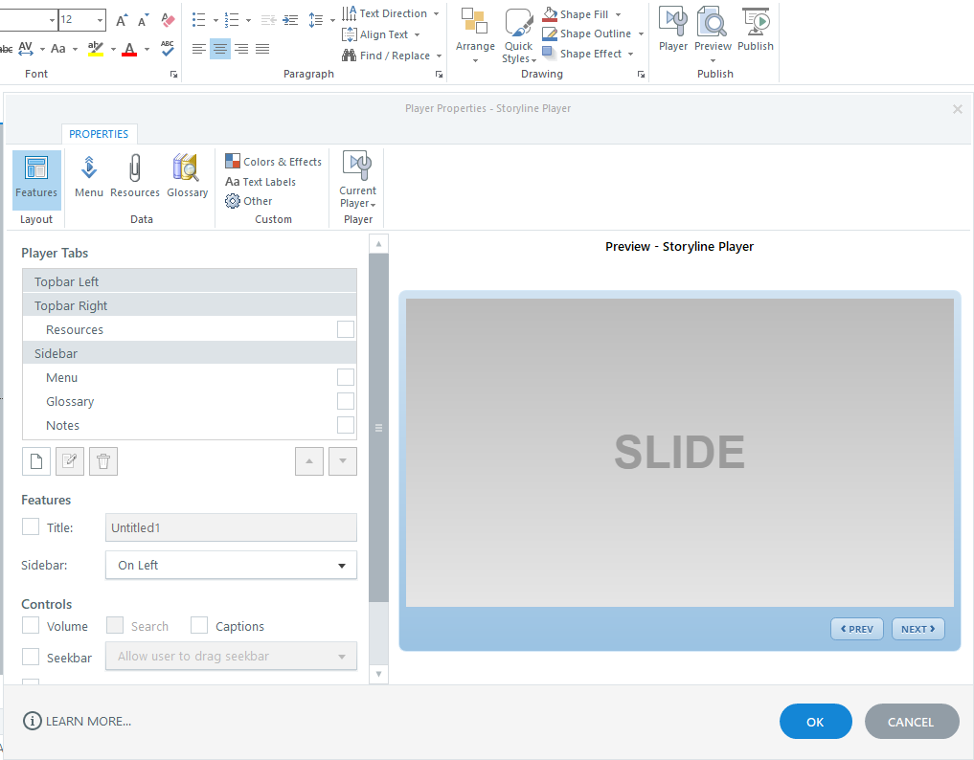
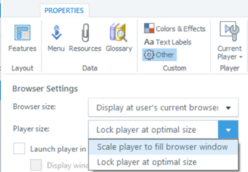
Let’s practice together with ARTICULATE
1: Choose the Gamified Theme
PLAYER: in the COLORS & Effects area you can decide to modify every part of the player (also the shadow under elements…)

Slide 23
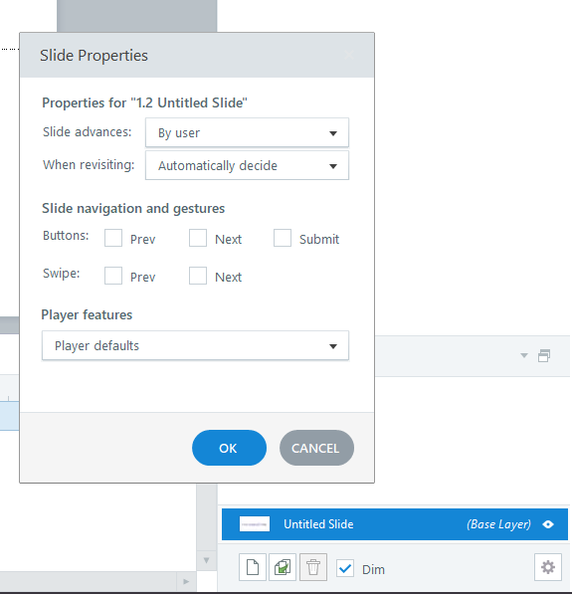
Let’s practice together with ARTICULATE
2: Identify the Game Design Elements
For each slides you have to click on the gear at the bottom, remove navigation buttons and swipes gestures.
From this panel you can decide the behavior of the slide when revisiting. Change it depending on the type of slide, for example, in the map maintaining the status, in the question slides reset to initial state in order to give user possibility to retry (if needed).
Double click on the “Untitled Slide” and give a unique name, it will be easier managing the user navigation.

Slide 24
Let’s practice together with ARTICULATE
3: Set Up the Storyline Project
To create effect between slides there is the TRANSITION menu
NOW YOU CAN CREATE DIFFERENT SLIDES, ONE FOR EACH LEVEL

Slide 25
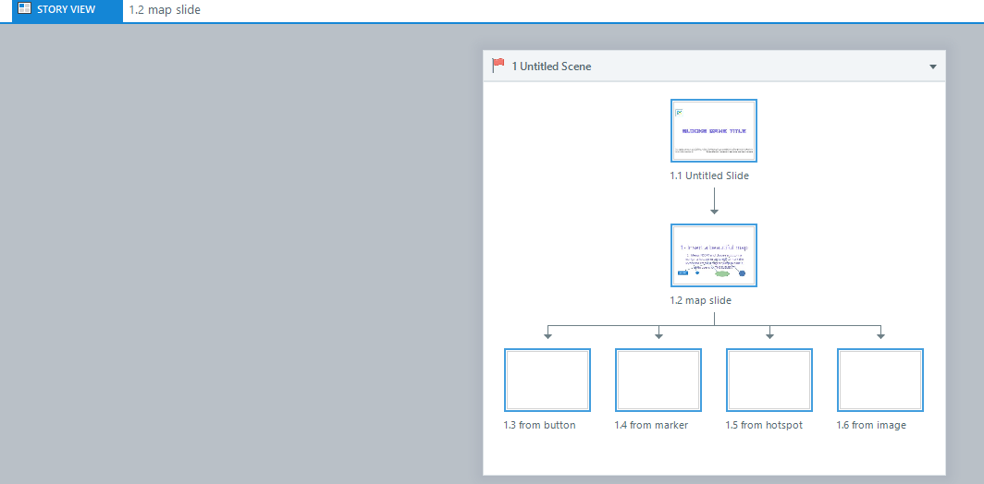
Let’s practice together with ARTICULATE
3: Set Up the Storyline Project
Use the STORY VIEW to see the graph of the game

Slide 26
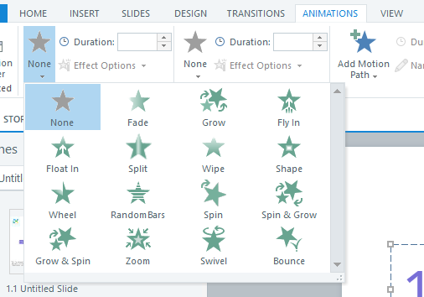
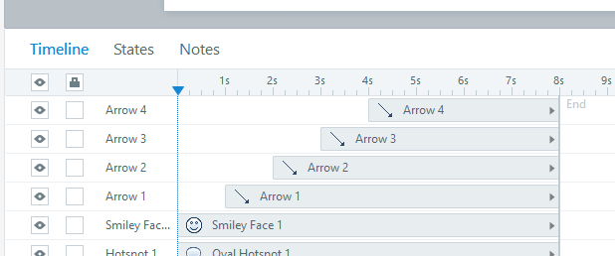
Let’s practice together with ARTICULATE
4: Build the Game Elements
Into slides you can insert all element, manage the timeline for entry/exit effect and adding ANIMATION

Slide 27
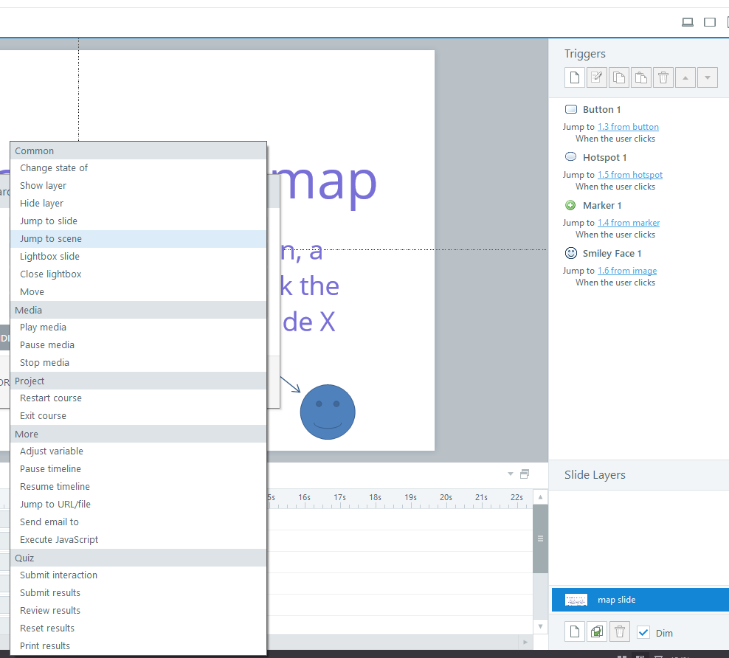
Let’s practice together with ARTICULATE
4: Build the Game Elements
You can create also extra interaction using basic slide and creating TRIGGER
In some object you can decide to jump slide, start events, etc…

Slide 28
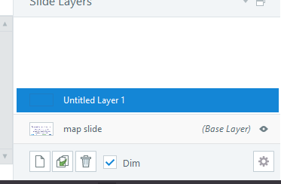
Let’s practice together with ARTICULATE
4: Build the Game Elements
You can create a new LAYER to add element into the slides, for example, some balloons over an element when you click some button, an overlapping effect, etc…

Slide 29
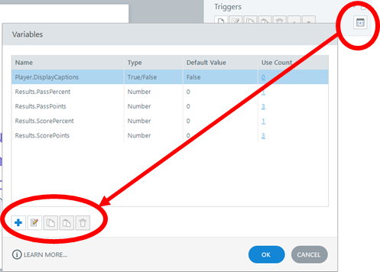
Let’s practice together with ARTICULATE
4: Build the Game Elements
Here you can create variables, decide type and default value.
For example, you can create a numeric variable for User LIFE and decrease it with the trigger “ADJUST VARIABLE” every slide you need, or create a true/false variable to check a specific status (eg. changing the status of an element hidden/normal if your variable is true/false…)
You can create multiple result slide, and blocking the navigation step by step OR using your personal variables to control the playability of the users.

Slide 30
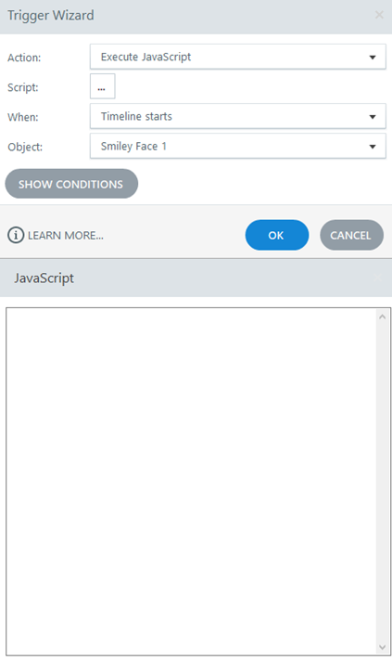
Let’s practice together with ARTICULATE
4: Build the Game Elements
In this trigger you can add JavaScript code, there is an online guide here:
https://articulate.com/support/article/Storyline-3-JavaScript-Best-Practices-and-Examples
Get the player object, get and set variables to manage extra elements in the slides. This is an advanced action so use it only if there is no other prebuilt option.
NOTE: use JavaScript and not jQuery because it was removed by the library for security issues, if you need to use jQuery you have to export you final project, open the story.html file and link it manually to the code.jquery.com file

Slide 31
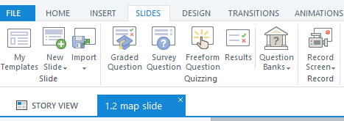
Let’s practice together with ARTICULATE
5: Build the First Quiz Question
There are many type of quiz slide
Graded Question for simple slides (true/false, check the correct ones, etc…)
Freeform Questions for Drag&Drop elements, select images, etc…

Slide 32
Let’s practice together with ARTICULATE
6: Build the Feedback Slides for the First Quiz Question
In the Questions Slides there is a special menu tab, you can define number of attempts (IMPORTANT: if 1 there will be no TRY AGAIN layer), shuffle the answers, or other particular settings for different type of slides

Slide 33
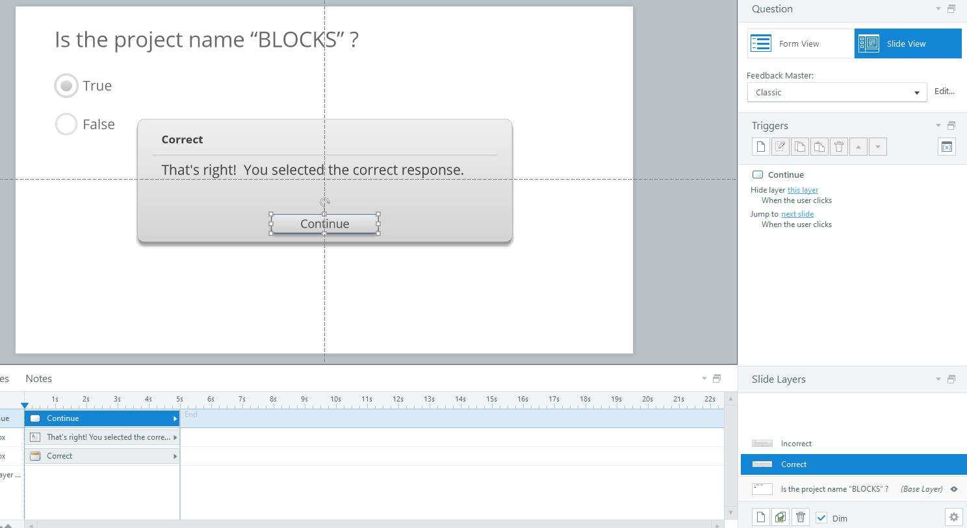
Let’s practice together with ARTICULATE
7: Adjust the Visual Feedback for the Game Button
In the Questions Slides there are pre-built layer, for the Correct – Incorrect – Try Again message
You can change the style of the slide, changing background, colors, adding elements to personalize these slides.

Slide 34
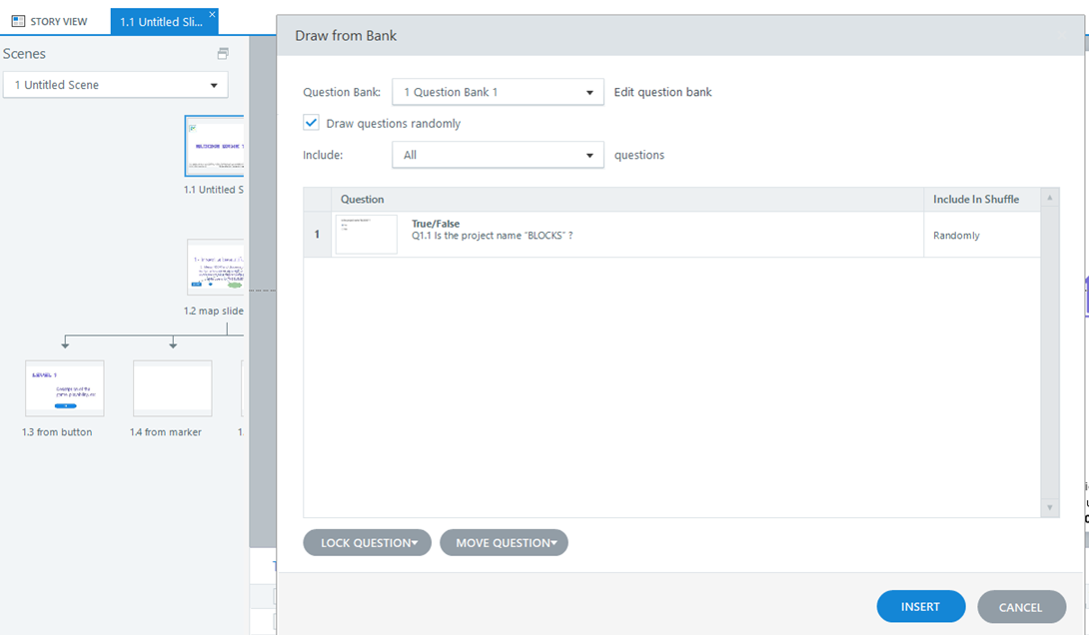
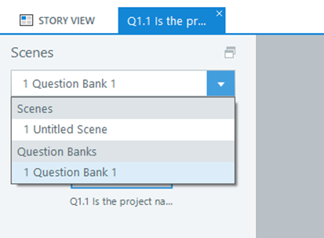
Let’s practice together with ARTICULATE
8: Create the Remaining Questions and Feedback Slides
Here you can select the Question Bank to create new questions.

Slide 35
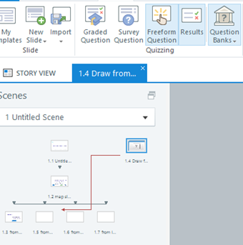
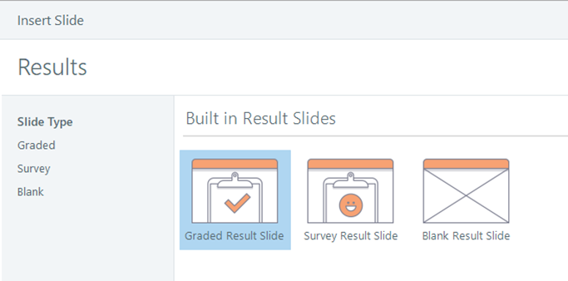
Let’s practice together with ARTICULATE
9: Create the Introduction and Results Slides

Slide 36
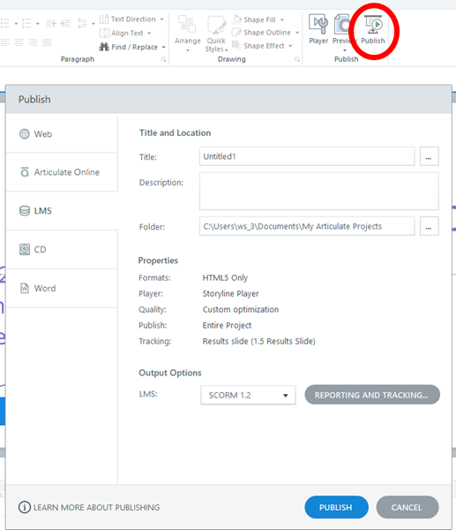
Let’s practice together with ARTICULATE
At the end, you can export your project
Click on PUBLISH button and select LMS or Web:
Give a title, optional description and the path to export
You can export in HTML5 FORMAT
ONLY FOR LMS - Choose the way of Tracking by your result slide
Be sure to export in SCORM 1.2
Now you can enjoy organizing your learning game!

Slide 37
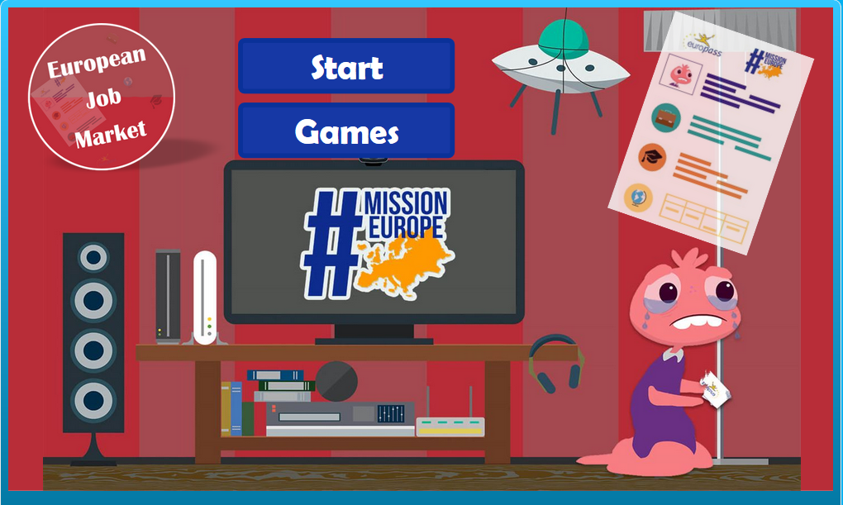
It’s time to play!
https://vitecoelearning.eu/missioneurope-game/european-job-market/

Slide 38
It’s time to play!
https://vitecoelearning.eu/ImmiMATH/Building a city/EN

