Slide 2
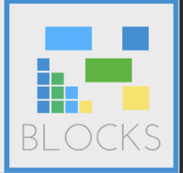
Agenda
Blockchain in Italy
Investment scenario
Blockchain in agrifood sector
The case of Cantine Volpone
The functioning of the technology
The rules to be applied
Problems to be solved
Possible solutions

Slide 4
Italy and blockchain: general perception
62% of Italians have never heard about blockchain. But 20%, that is one in five is somewhat informed.
The most informed are obviously the under 35 with a high level of education.

Slide 5
Italian managers perception
Only 4% of managers have never heard of blockchain: a surprising fact in many ways, which bodes well for the acceleration of this technology. In companies, therefore, the theme is known but this does not mean that they are ready to pass from knowledge to application. Meanwhile, as it is easy to imagine, the most informed are the company technology, the IT area, and therefore the opportunity has not always already reached the decision-making and strategic levels of the companies.

Slide 6
Manager perception about possible applications
In the perceived of managers the blockchain in the coming years will be useful above all for product traceability, document management and supply chain management. Interesting and in some ways unexpected the fourth place for the finance area. This means that the blockchain has (almost) released itself from bitcoin to be considered as a new opportunity for innovation in (almost) every business area. Still to illuminate and enhance logistics, which instead could have great advantages from the adoption of technology.

Slide 7
…continue
Blockchain is seen as an opportunity to reduce business costs but also as an element that increases complexity in the company. Certainly it is a technology that will not bear fruit until it is confined to the IT department. From this point of view it is a great sign of maturity the signaling that comes from the sample of managers on the skills necessary to use it: the majority says that organizational skills and knowledge of processes are needed. Only afterwards and there are technological skills. The confirmation of an increasingly widespread awareness: the blockchain is not one of the many new technologies to be implemented in existing models. It will be a real business revolution.

Slide 8
Italian investment scenario
In 2018 the companies of our country have invested in projects related to the blockchain altogether 15 million euros in 150 projects that range from training and strategic consulting to consultancy to learn about platforms and develop pilot projects.
For the moment, in any case, only large companies invest in blockchains.

Slide 9
Investment barriers
Lack of competencies.
Difficulty in evaluating the benefits.
Lack of available resources: 30% of companies have a budget of less than 100 thousand euros, 7% have budgeted resources between 100 thousand and 500 thousand euros and only 4% invested more than 500 thousand euros.

Slide 10
Let’s see some stats
Notes:
Italy is among the top 10 countries for number of blockchain project and 30% of projects are related to the supply chain and agritech sector

Slide 11
Blockchain architectures chosen by italian blockchain companies
Notes:
For many SMEs the lack of understanding and trust in the new technology can be a deterrent for its integration in the company’s operations. For this reason, some international companies are offering their support. Even for the business case I’ll show you the company has been supported by a big company like EY.

Slide 12
Source of financing
Notes:
The majority (60%) of Italian entrepreneurs surveyed in the blockchain space resort to personal funds as the primary source of financial resources to operate their business, with another relevant share (20%) relying on them as secondary sources (Figure 25).

Slide 13
Forms of cooperation of blockchain firms in Italy
Notes:
Most blockchain companies have a strong relation with researchers and Italian universities and are playing a major role in the development of the blockchain ecosystem. Almost two companies out of three (63%) indicated some sort of cooperation with local universities (see Box 5 for an example). Many of the interviewed companies indicated that the partnership with researchers in universities were organic and structural to the development of the products and of the businesses, and not just for single-shot consultancy support

Slide 14
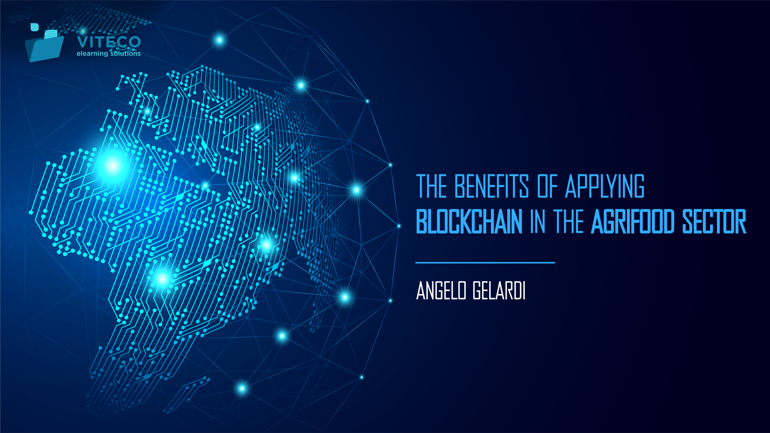

Slide 15
Smart Agrifood in defense of the Made in Italy
Consumers are increasingly focused on the products’s origin.
74% of consumers explicitly state that they are influenced in their purchase by the availability of information on product traceability issues.
Notes:
Primo blocco: on the raw materials used, on the issues of sustainability and the quality of the methods used for the cultivation of the food that then arrives on our table.

Slide 16
The wine sector in Italy
The market is characterized by companies that struggle to bring the values of the territory, method and professionalism to the end customers.
High counterfeiting phenomenon. It’s estimated that every year there is a loss of 2 billion euros.
Notes:
Primo blocco: on the raw materials used, on the issues of sustainability and the quality of the methods used for the cultivation of the food that then arrives on our table.

Slide 17
The subjects in the wine supply chain
Notes:
Protection: product certification and authenticity guarantee with blockchain
Anti-counterfeiting: ACCESS TO ALL INFORMATION REGARDING THE ORIGIN AND PRODUCTION OF THE WINE
Control: EVERY PROCESS AND VINIFICATION TECHNIQUE IS REGISTERED AND VERIFIED
Trust: CONSUMERS LEARN MORE ABOUT THE WINE BOTTLE, INCREASING THEIR LOYALTY TO THE PRODUCER

Slide 18
The benefits from the use of Blockchain
Protection
Anti-counterfeiting
Control
Trust
Notes:
Protection: product certification and authenticity guarantee with blockchain
Anti-counterfeiting: ACCESS TO ALL INFORMATION REGARDING THE ORIGIN AND PRODUCTION OF THE WINE
Control: EVERY PROCESS AND VINIFICATION TECHNIQUE IS REGISTERED AND VERIFIED
Trust: CONSUMERS LEARN MORE ABOUT THE WINE BOTTLE, INCREASING THEIR LOYALTY TO THE PRODUCER

Slide 20
Cantine Volpone
The Volpone wineries, ancient wine cellars of Puglia, developed in 2017 in collaboration with EY Italia a solution for the tracing of the wine production chain, which allows the self-certification of the entire production process.
The system offers a virtual KM-zero, or a digital relationship between producer and consumer that, through a label cleverly placed on the bottle of wine, it lets you know the entire process of wine production and transformation.
Blockchain guarantees the immutability of the data.

Slide 21
The project: how it works
The base of this solution is represented by a database that contains a register of all the transactions and all the steps that characterize the production and transformation of wine.
Each participant in the chain is in the position to verify the validity of the entire chain of transactions and steps.
The blockchain has been developed to guarantee a process of sharing all the information connected to the product online and to enable the consumer to verify, at any moment, the origin of the product, its organoleptic characteristics and the steps related to the entire supply chain.

Slide 22
The integration process: winegrover
1) A network of sensors is being created that automatically collects data on weather, soil conditions and other parameters;
2) The winegrower enters the system with data about himself and the land plot (location, height, type of soil), type and number of vines, their origin, irrigation and processing;
3) When harvesting, data about the date of harvest, how the grapes are delivered to the winery, etc. are entered into the system.

Slide 23
The integration process: winemakers
Notes:
Data on suppliers, grape variety; date of receipt of raw materials; description of the state and quality of the obtained raw materials; data on the conditions of its delivery.
Records of internal procedures, such as decantation, fermentation and preservation, as well as aeration in the production of rose wine.
Information on temperature, chemical content and additives.
Data on storage conditions and production spill.
Information about yeast and its use.

Slide 24
The integration process: distributor
The main functionality of the app is the scanning of the "tag" (Qr code or other), which allows the consumer to identify the wine and access related information.

Slide 25
The information provided
The wine page offers information above all on the production process, but also on promotional activities in social media.

Slide 26
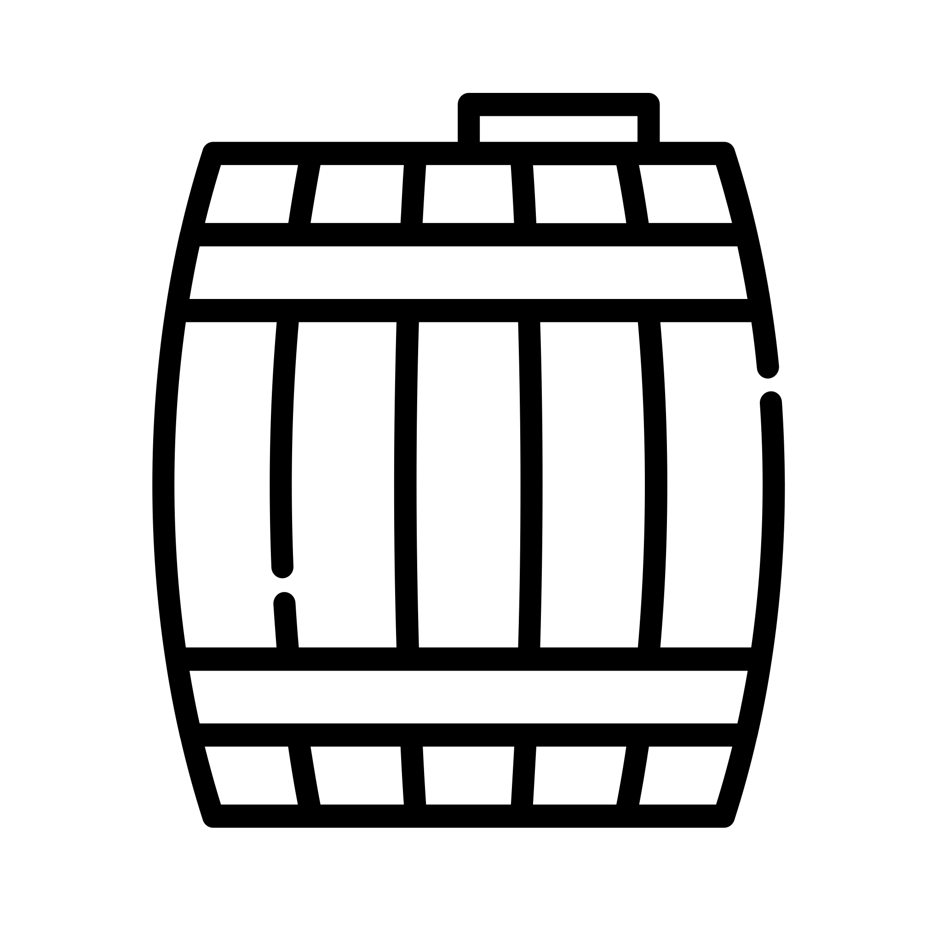
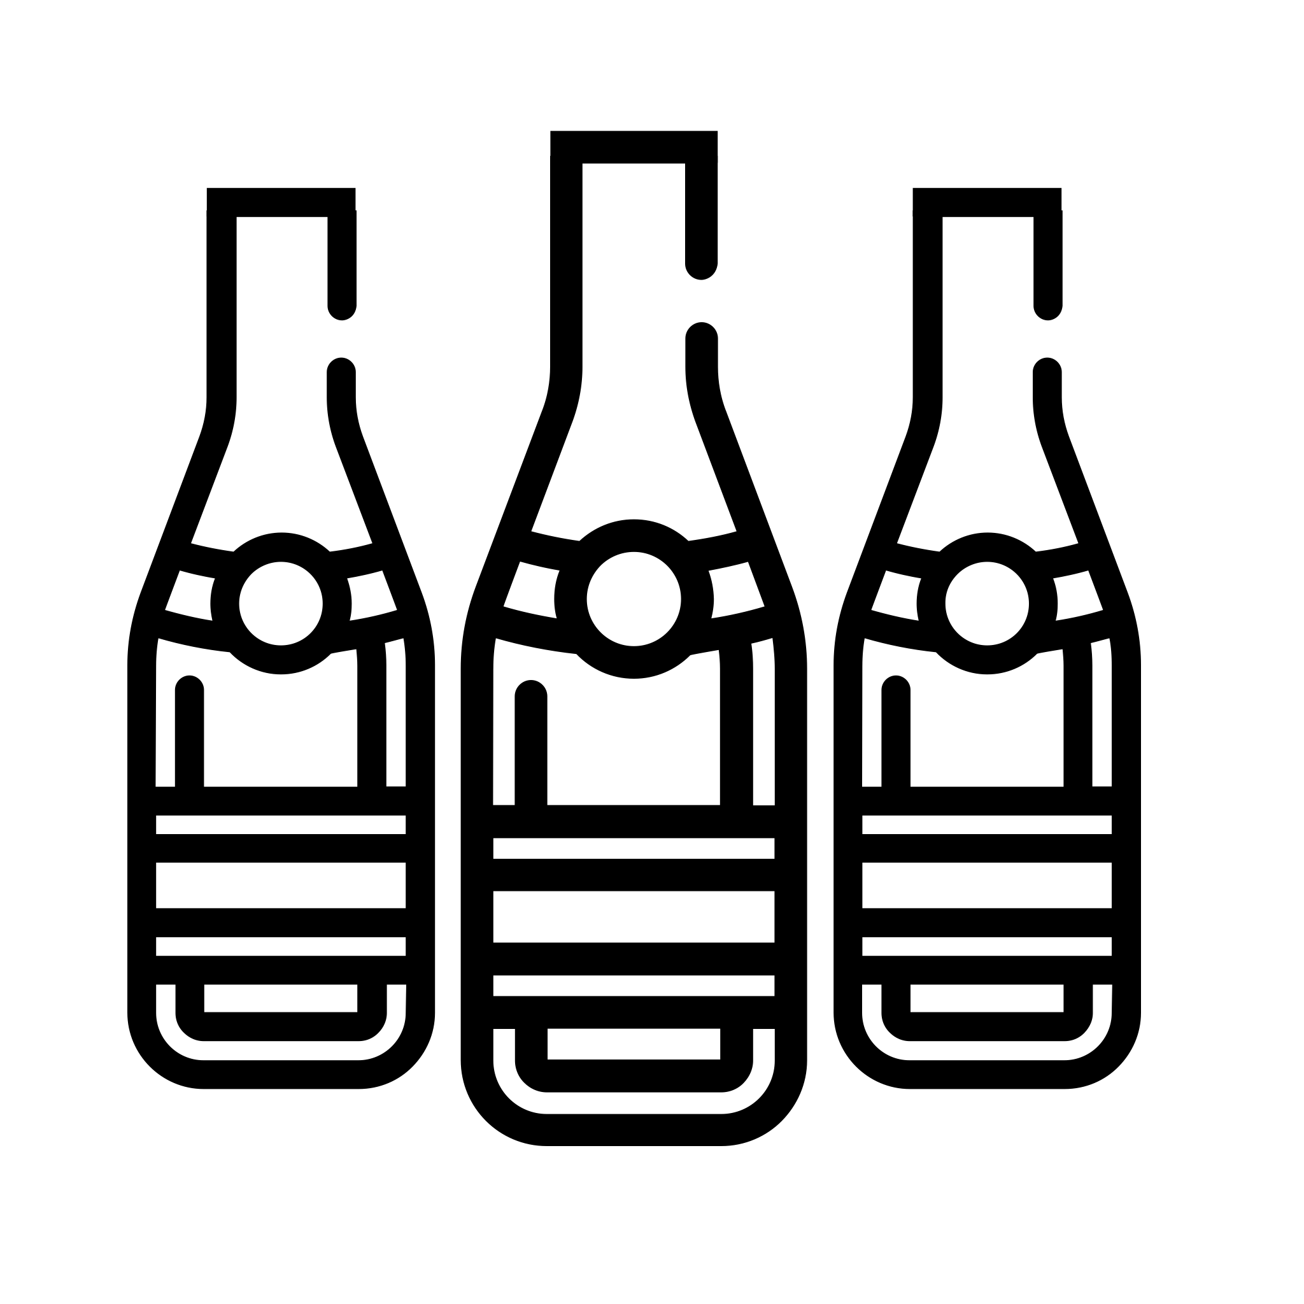
The information provided
All information relating to the geographical area of ​​wine production, in particular the vineyard.
Detailed information on pesticides, fertilizers and plant growth stages, following a specific time-line.
All the steps of wine production with a time tag and a description of the process.
Data relating to the total quantity of wine produced (in liters) and the number of bottles distributed throughout the world.

Slide 27
The project explained
Notes:
https://www.youtube.com/watch?v=d3QGvjPYFAw

Slide 28
….but
Although the blockchain provides great opportunities to fight counterfeits, it is not able to stop all types of fraud. Thus, the distribution register will prevent the creation of several copies of the same wine, the substitution of expensive varieties for cheap, the sale of counterfeit goods and spoiled goods.
Fraudsters can always enter a market with a clean reputation, for example, by creating a new legal entity that is engaged in wholesale or retail sales. It is impossible to prevent this.

Slide 30
The European Legislation for the agrifood sector
Food legislation is varied, made up of community and national dictates and, among all, the Regulation (EC) no. 178/2002, also known as the General Food Law Regulation, which establishes the general principles and requirements of the relevant legislation, establishes the European Food Safety Authority and establishes procedures in the food safety field.
The Regulation aims to promote cohesion between Member States, through the adoption of international technical standards, general safety requirements as well as uniform food legislation, ensuring that the level of protection adopted in the Community is the same in each country.

Slide 31
…and the role of blockchain?
Lastly, the recent EU Regulation no. 625/2017 introduced stricter provisions with the aim of harmonizing and simplifying the regulatory framework relating to controls in the food chain.
Blockchain-based platforms, thanks to their intrinsic characteristics - decentralization, transparency, security, distributed consent and integrity, can implement solid track and trace functions, connecting the subjects involved in the production and distribution of food and allowing to record in a shared public register every movement and transformation of products, including environmental information, during the "from farm to fork" process.

Slide 32
There are also some issue to be solved
Among the greatest challenges is that linked to compliance with privacy regulations, as all transactions and recorded data are publicly visible: an excess of transparency could cause problems related to the processing of sensitive data.
Linked to the new GDPR the main problems are related to:
The identification of the data controller;
The non-possibility to change the content of blocks after registration.

Slide 33
Possibile solution
Part of the aforementioned problems could be overcome through the application of permissioned blockchain, managed by consortia of companies or government bodies, in which it would be possible to define the roles of the participants and impose data processing rules, in compliance with current legislation.

Slide 34
To sum-up
Blockchain technology represents one of the biggest opportunities for the future and an effective way to ensure the origin of products and thus safeguard producers and consumers.

